Slide 1
Report: ABC Call Volume Trend Analysis
1. Project Description
The project analyzes a dataset of an insurance company’s Customer Care team for 23 days. The dataset includes information about agents, call durations, and statuses. AI tools like IVR, RPA, Predictive Analytics, and Intelligent Routing are used to improve customer experience. Roles within the team include call center agents providing support through different channels. Inbound support aims to attract and engage customers for business growth. Advertising plays a crucial role in marketing, shaping initial impressions and increasing sales. Analytical skills are utilized to identify cost-effective advertising methods. The project involves analyzing customer care data, exploring AI tools, understanding employment opportunities, and recognizing advertising’s significance for business growth.

Slide 2
2. Approach
1. Understanding
Getting a thorough understanding of data and what impact it has on the target.
Cleaning
Handling irregularities in data for better analysis.
Analysis
Analyzing the data to draw insights and conclusions.
Visualization
Visualize the analysis.

Slide 3
3. Tech-Stack Used
Microsoft Excel:
Data Cleaning
Data Analysis
Visualization
PowerPoint

Slide 4
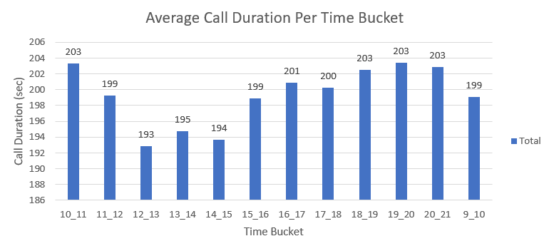
4. Insights
Task 1. What is the average duration of calls for each time bucket?

Slide 5
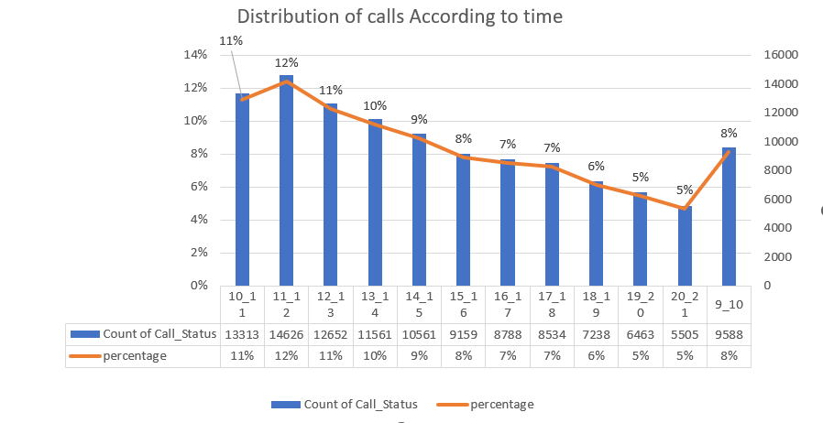
4. Insights
Task 2. Can you create a chart or graph that shows the number of calls received in each time bucket?

Slide 6
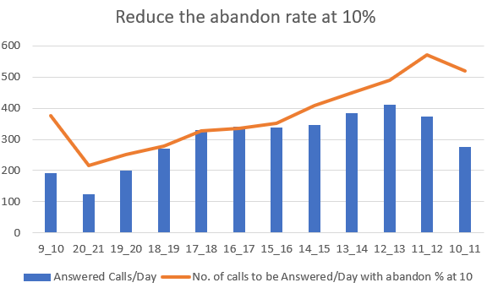
4. Insights
Task 3. What is the minimum number of agents required in each time bucket to reduce the abandon rate to 10%?

Slide 7
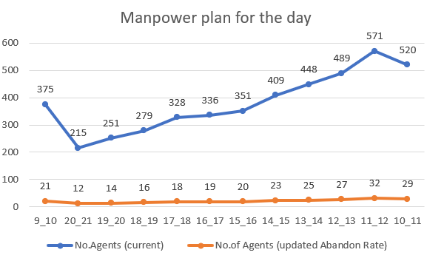
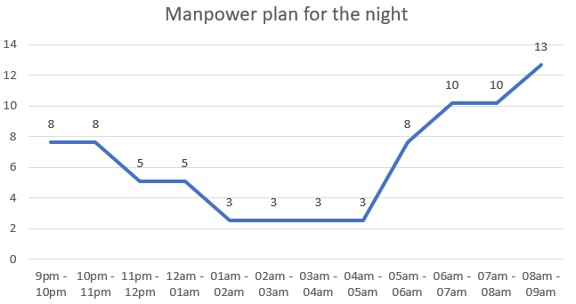
4. Insights
Task 4. Propose a manpower plan for each time bucket throughout the day, keeping the maximum abandon rate at 10%.

Slide 8
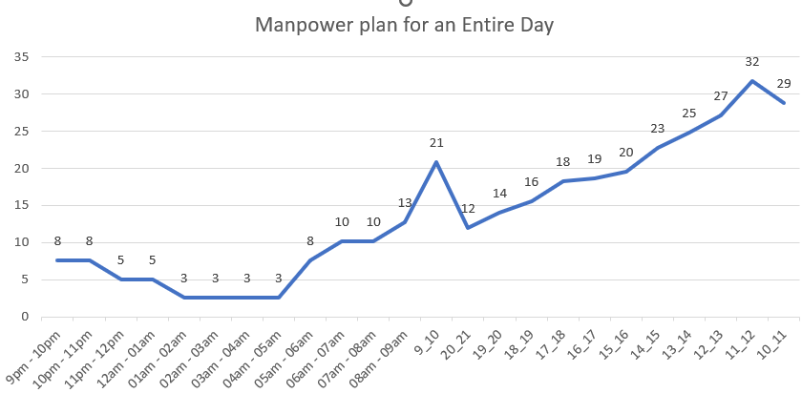
4. Insights
Task 4. Propose a manpower plan for each time bucket throughout the day, keeping the maximum abandon rate at 10%.

Slide 9
5. Result
The call abandon rate by the agents at the start and towards the end of the shift is very high. The number of calls being abandoned is because of the reason for such high management must have a strong look if the agents not being monitored properly towards the start and end of shifts or if the rate is high because of reasons such as team meetings towards the start and end of day.
If the call abandon rate is high because of reasons such as team meetings, they should be conducted during afternoon hours between 4pm to 6pm where in call abandon rate is below 10%.
Excel file :Link
Video link : link

Slide 10
Thank You !

